Slide 1
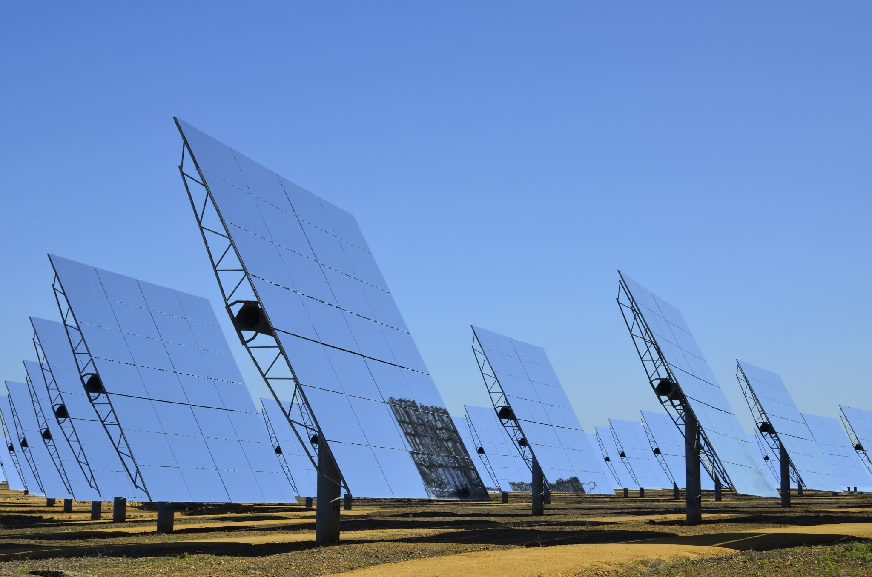

P4A- Solar Mini grid
Socioeconomic Impact

Slide 2
Introduction
Renewvia published its first peer-reviewed study on the use of solar mini-grids
Performed a general analysis on their effects
Study took place in Kenya and Nigeria
Our task:
Continue to analyze the data
Find interesting patterns related to subgroups
Analyze the impact of Renewvia’s work

Slide 3
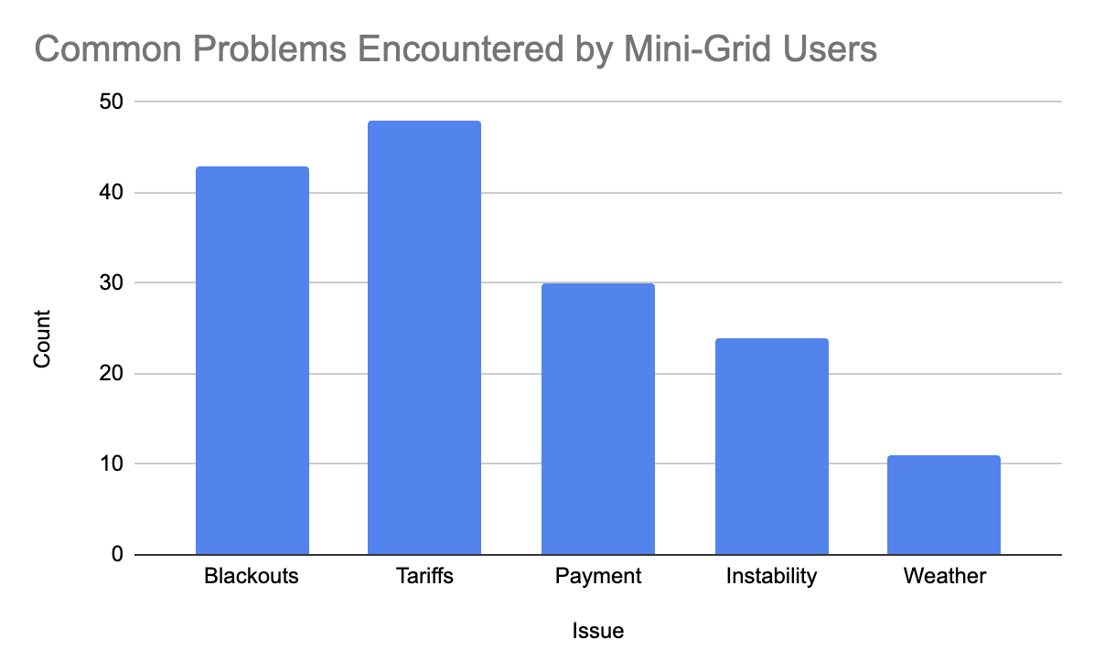

Mini-grid Issues
Found top five most common issues across all communities using word frequency analysis

Slide 4
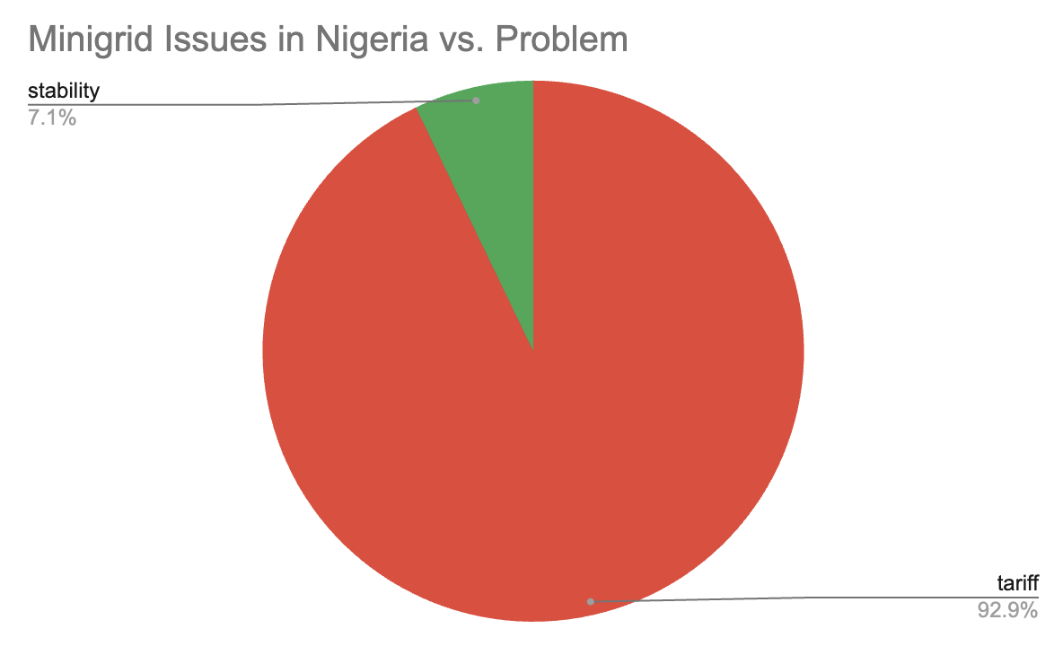
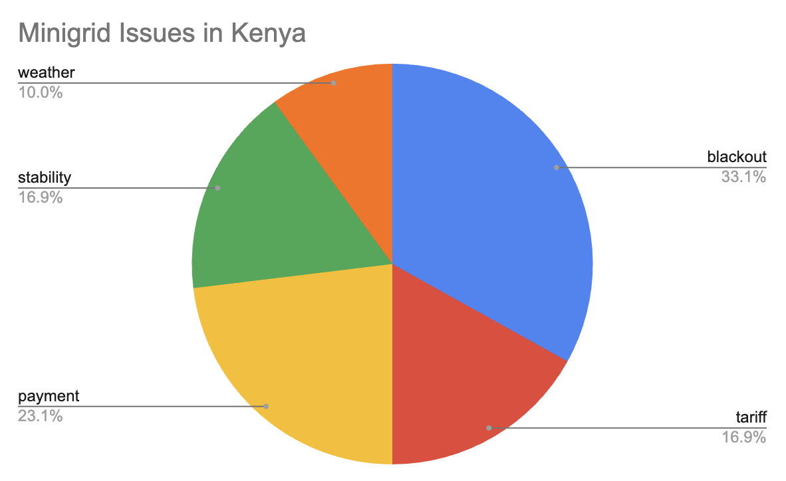
Mini-grid Issues by Country
Nigeria mostly struggled with tariff issues
Stability was their only other issue, only 2 out of the ~80 businesses
Kenya had a larger number of issues in general
They encountered all five of the top problems
Blackouts were the largest issue

Slide 5
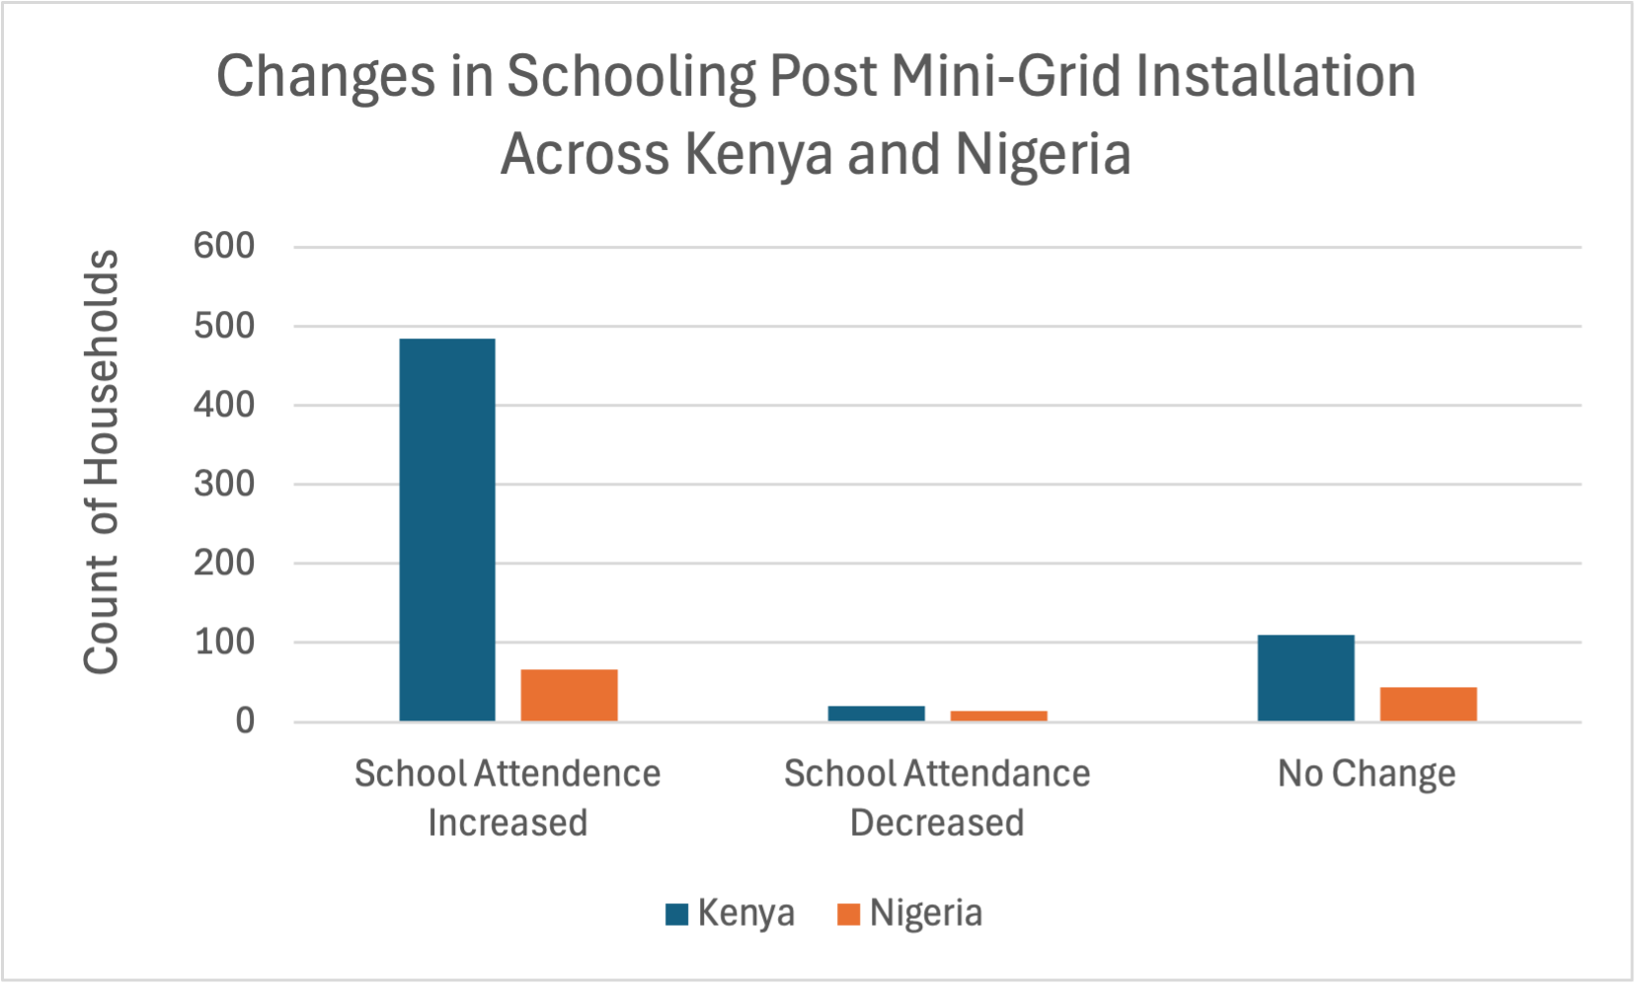
Changes in Schooling Post Mini-Grid Installation Across Kenya and Nigeria
Kenya had a much larger increase in the number of children in school after mini-grid installation
No significant differences in the decrease in attendance between the two countries
No significant differences were found across genders

Slide 6
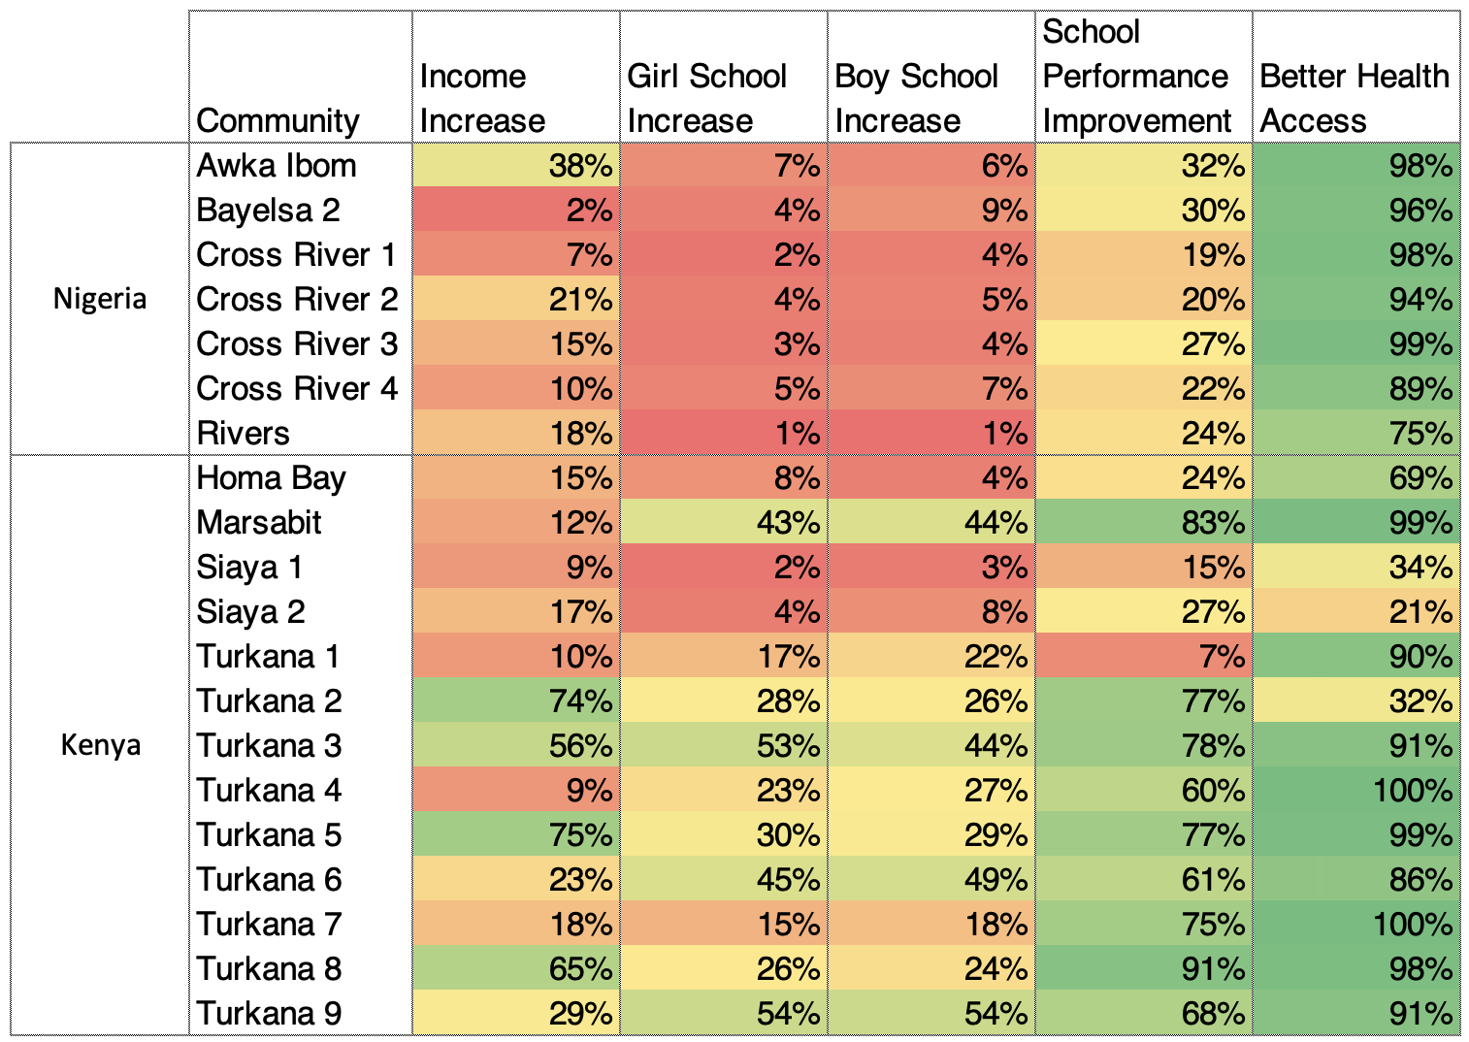
Community Comparisons
The Turkana Communities saw greater improvements in income, school performance, and school attendance for both girls & boys compared to other communities
Notes:
Here I compared the different communities across some key attributes post mini-grid implementation. These include if a household had an income increase, if more girls started attending school, if more boys started attending school, if school performance increased, and if they had better access to healthcare.
Notably, the Turkana communities saw greater improvements in income, school performance, and school attendance for both girls & boys compared to other communities. The Nigeria communities as seen at the top had notably lower increases in school attendance and performance

Slide 7

Partner Engagement
To obtain partner feedback, we scheduled and participated in regular video meetings with the VP of Engineering for Renewvia, Nicholas
We incorporate this feedback by engaging in a deeper analysis of data patterns and working on his desired deliverable of an extensive report on novel analysis of the data

Slide 8
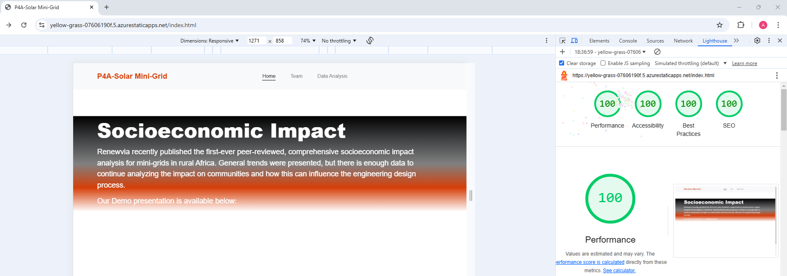
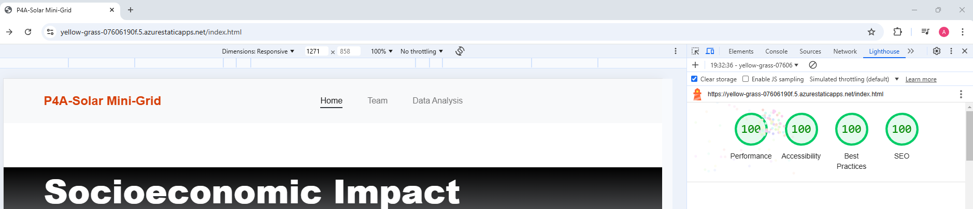
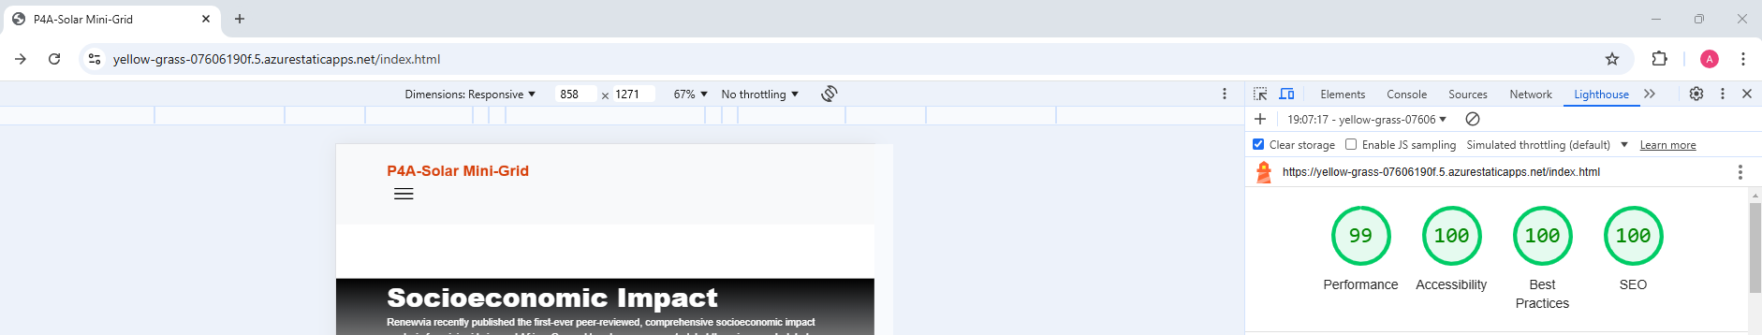
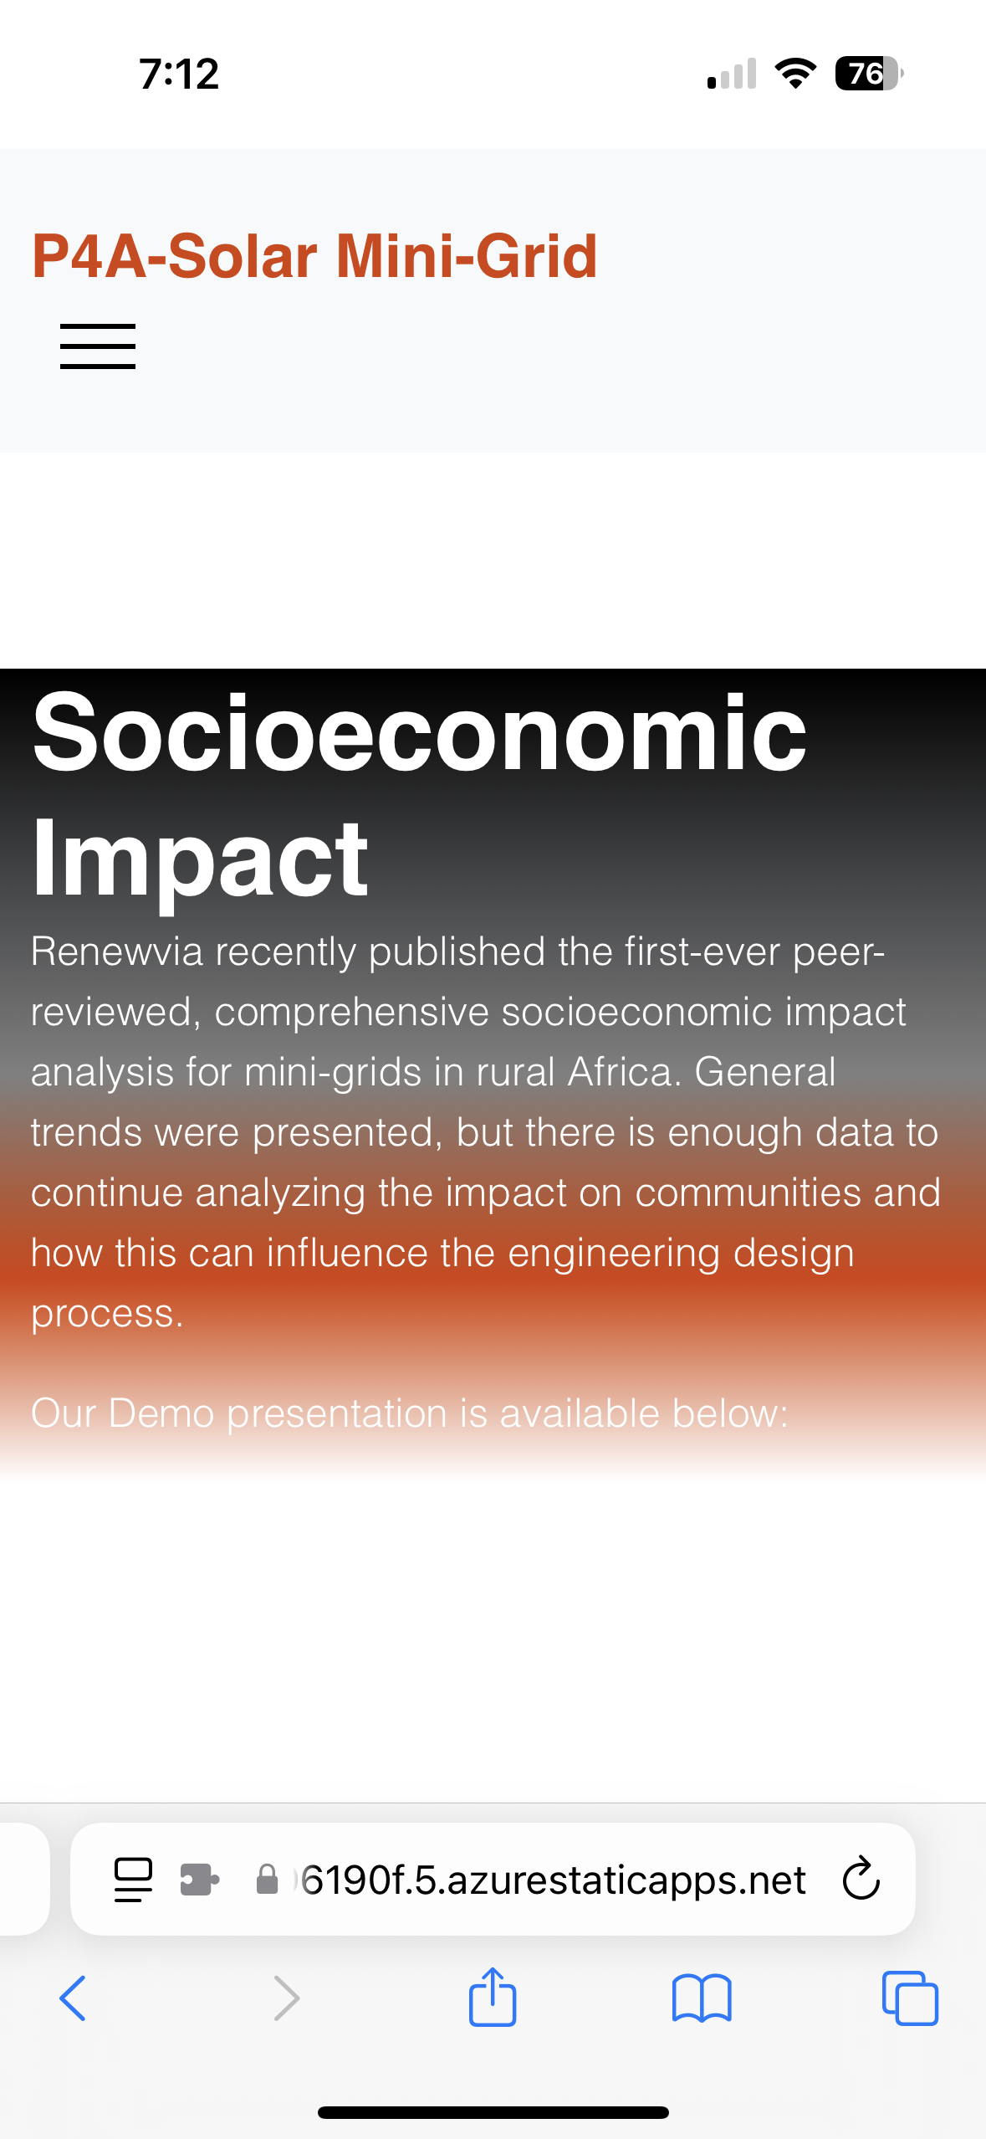
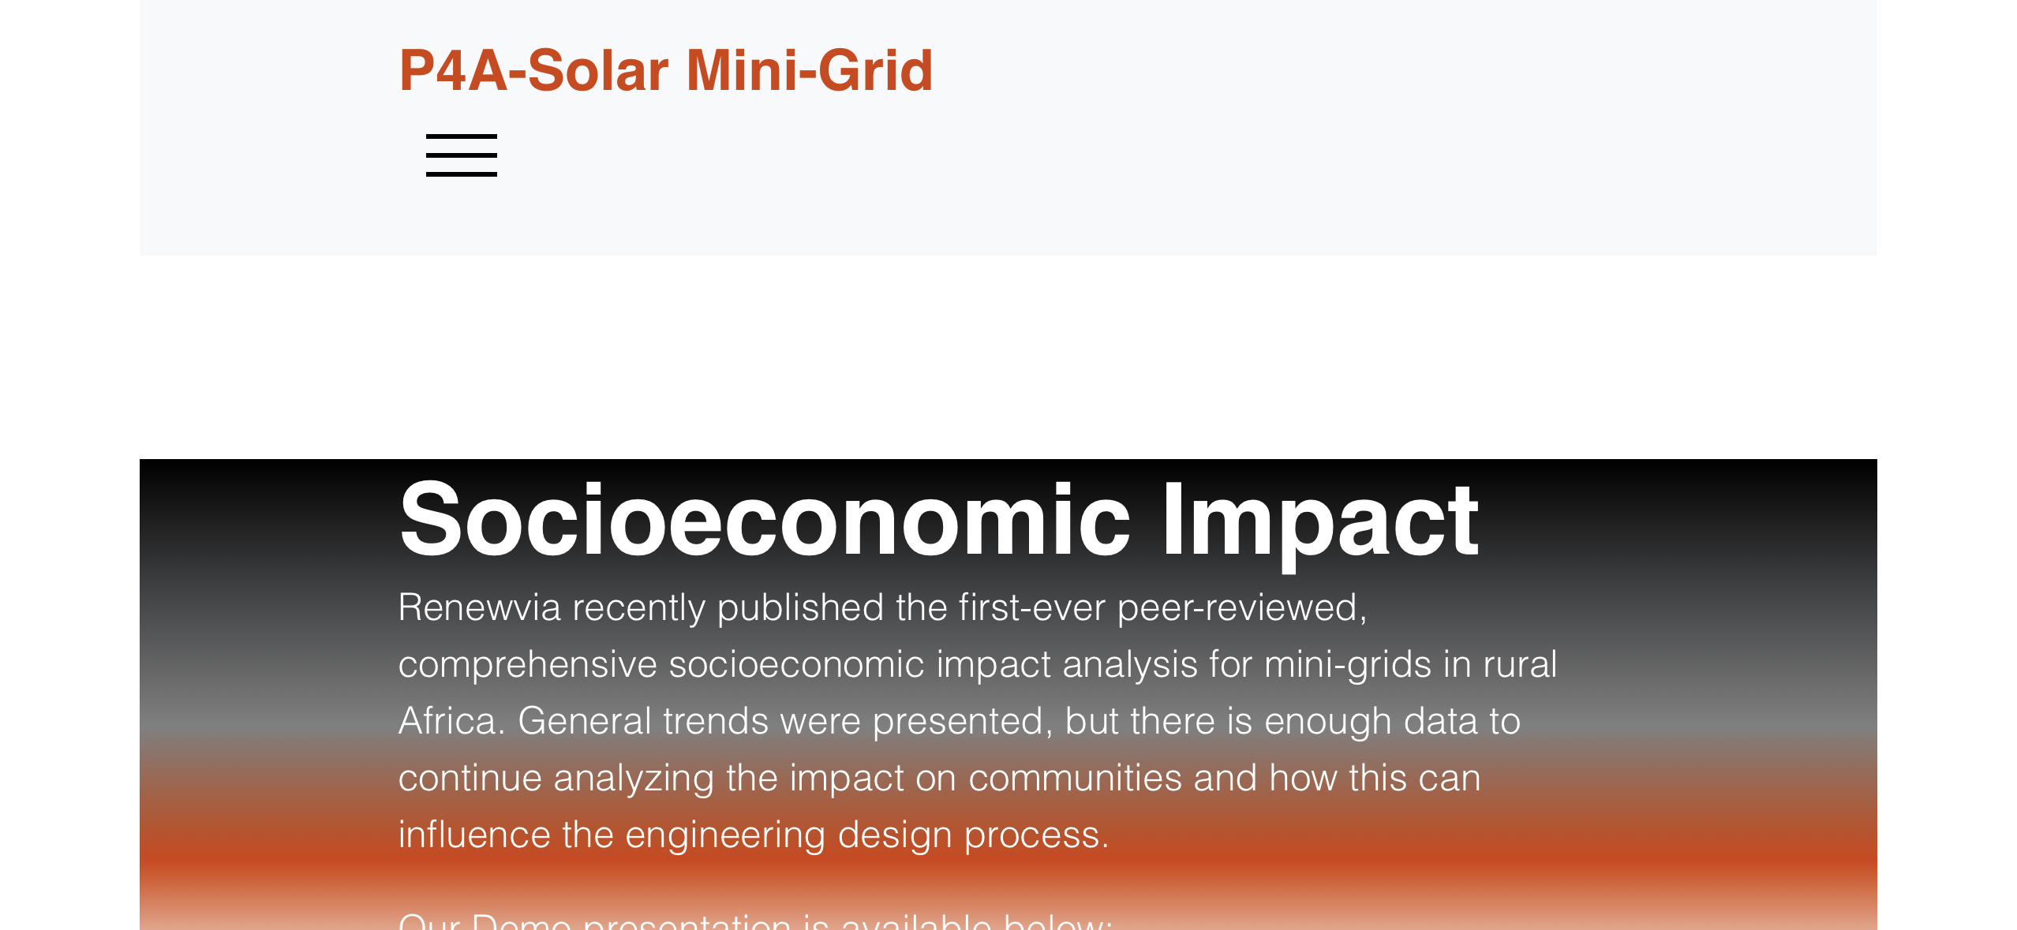
Lighthouse Score Demonstration
Lighthouse Desktop: 100/100/100/100
Lighthouse Mobile Landscape: 100/100/100/100
Lighthouse Mobile Portrait: 99/100/100/100
IOS screenshots

